Slide 1


Search And Rescue Optimal Planning System
SAROPS
Thomas M. Kratzke and Lawrence D. Stone, Metron Inc
John R. Frost, U. S. Coast Guard
Presented on July 28, 2010
at
FUSION 2010

Slide 2
History and Background
As a result of air-sea rescue operations during the WWII, the US Coast Guard established the Air Sea Rescue Agency in 1944
  Used “Methods of Locating Survivors at Sea on Rubber Rafts” US Navy Hydrographic office, 1944 for planning searches – influenced by Koopman’s work in ASWORG later reported in “Search and Screening” 1946.
  In peace time this became Search And Rescue (SAR)
    USCG published first Search and Rescue Manual in 1959 based on Koopman’s 1956 -7 articles on search theory in Operations Research
    Manual method given in this publication remained basic technique until 1967 – minimax technique added to account for uncertainties in leeway
  SARP – Search And Rescue Planning program - 1970
    Computer version of manual methods with some additions
Computer-Assisted Search Planning, CASP developed in early ’70’s.
  Deployed in 1974 on a CDC 3300 in Washington, DC
  Monte-Carlo simulation
  Search Planning aid was primarily a display of cellular distributions.
  In use until March 2007!

Slide 3
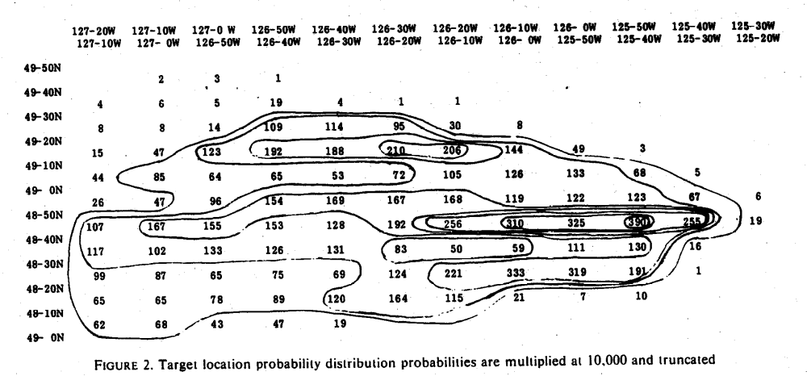
Early CASP Probability Map

Slide 4
History and Background
Search and Rescue Optimal Planning System (SAROPS) development began in October 2003. Designed to take advantage of better
  Environment Data information – winds, currents, visibility, cloud cover
  Models for
    Drift and leeway of search objects
    Search sensors
  Theoretical developments in search planning
    Search for moving objects, multiple search object types, survivor search
  Computer computational power and geographic displays
SAROPS became operational in March 2007.
  Developed by Northrop Grumman, Metron, and Applied Science Associates (ASA)

Slide 5
Early SAROPS Success
Cruise Ship Passenger Goes Overboard; Is Rescued 8 Hours Later
  By Robert Nolin and Ihosvani Rodriguez; South Florida Sun-Sentinel March 17, 2007
Michael Mankamyer was 30 miles off Fort Lauderdale treading water in choppy seas.
  Eight hours earlier, the 35-year-old Orlando man had jumped from a cruise ship balcony
  Rescue officials were at a loss to say why, though a witness said he was drunk.
But salvation came at 8:45 a.m., when a lookout on the Coast Guard cutter Chandeleur, Petty Officer Ryan Coon, saw Mankamyer in the fresh sunrise about 75 yards away.
He was shirtless, splashing and thrashing his arms.I knew that was our guy," Coon told reporters Friday evening.
  "I hollered out, `Man overboard, portside!'“ The crew threw Mankamyer a life ring; he swam up and grabbed it.
  "When I saw that he still had the energy to swim, I knew we weren't going to have any problems," said Lt. James Bernstein, commander ofthe 110-foot Chandeleur.
Nancy Nelsen, a civilian search and rescue specialist in the Coast Guard's Miami office
  credited a new computer model, the Search and Rescue Optimal Planning System, or SAROPS, for helping locate Mankamyer.
  The system analyzes wind and currents and uses an animated grid model to project where a floating person could be.

Slide 6
Basic Components of SAROPS
Environmental Data Server (EDS) developed by ASA
  Gathers and provides environmental products for SAROPS
Simulation (SIM) developed by Metron
  Produces and updates probability distributions for location of search object
Planner developed by Metron
  Recommends search patterns for ships and aircraft to maximize detection probability (probability of success).
Graphical User Interface (GUI) developed by Northrop Grumman
  Uses a ArcGIS as base for GUI

Slide 7
(CMF)
CJMTK Mapping Framework
(ArcGIS 9.2)
COP
EXT
WWW
TMS
GEBASE
EDS
Maptech
MORE
EXT’S
3D Analyst
SAROPS Extension
GUI
SIM, Planner
SAR Tools Extension
Flares, Patterns, Etc
Spatial - A
GeoStat - A
WeatherFlow
SAROPS
C-Map
Other…
Notes:
Block diagram of SAROPS to ArcGIS and other software.
SAROPS is an “extension” of ArcGIS

Slide 8
Goal: Assist in Planning Searches for People Missing at Sea
Three Parts to the Problem
  Gather the information from the user on what is known.
    GUI and EDS
  Compute a probability distribution for the location of the missing person.
    Simulator
  Given a distribution and Search and Rescue Units (SRUs), how do we deploy the SRUs to maximize our chance of finding the missing person?
    Planner
Focus of this talk is the Simulator and Planner

Slide 9
Simulator
  Monte-Carlo simulator produces distribution
  Pre-distress is described with scenarios.
    Examples: Sequence of waypoints, Dead-Reckoning, Last-Known Position. SAROPS has these and other scenario-types.
    Scenarios carry weights.
    Each Scenario has its own collection of particles.
  Transition to distress
    “Uniform” draw for when the distress occurred
      Influenced by hazards
    Draw for the type of post-distress object
  Post-distress motion
    Moves according to the winds and currents
    They affect different object types differently

Slide 10
Example of Scenario
Fishing Area A
Probable Error of Turn Point Position
Home Port
Fishing Area B

Slide 11
Example of Scenarios and Object Types
  Two Scenarios (Pre-Distress Motion)
    (P = 0.7) We think he went fishing in fishing area 1 and then on to fishing area 2. In this case, he went 12 kts, …
      For an individual particle, correlation between the position in fishing area 1 and fishing area 2.
    (P = 0.3) But we also heard a mayday and it might have been him. In this case, he has been adrift from a roughly circular area, for the last 12 hours, …
  Two Object Types (Post-Distress Motion)
    He got into a raft (P=0.4) or he is in the water (P=0.6)
      Former case; his position is more influenced by the winds
      Latter case: his position is more influenced by the currents
  Post-Distress Motion
    Uses environmental data and random fluctuations
    Fluctuations are correlated for a single particle

Slide 12
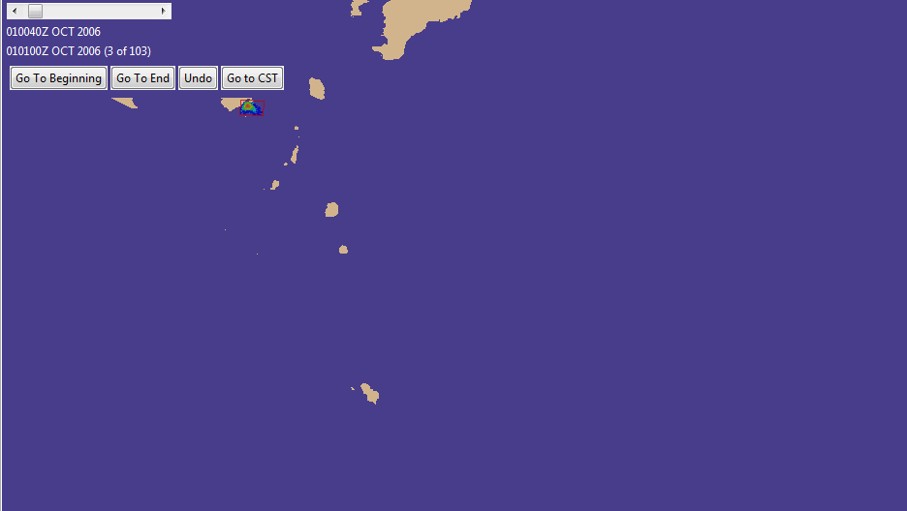
Example: Prior
  Last Known Position Scenario
  Distribution as of Distress Time
  (Just below the “Go to CST” Button)

Slide 13
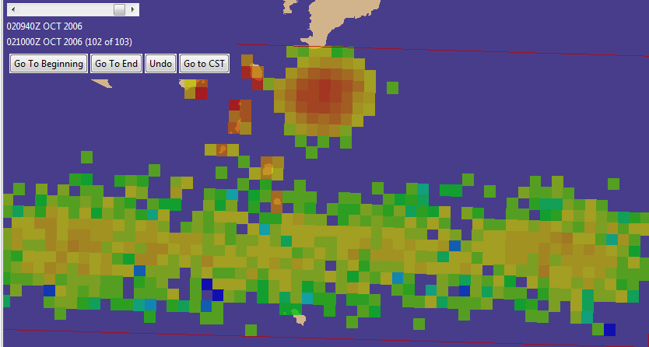
Example of Distribution from Drift
  Winds are from the north and “sent the rafts” into the southern band, with the two modes from gybing. Winds had little effect on “the PIWs.”
  Currents are to the east and the northern mode is PIW

Slide 14

Updating for Unsuccessful Search
Search takes place from aircraft or ships.
  Search paths are in form of straight line segments
  Sensors are typically visual but can be radar.
  Sensors are characterized by a lateral range function λ which gives probability of detection as a function of distance at point of closest approach (on a “long” straight line search segment)
Probability distributions for object location is given in terms of a set (say 4,000) of particles. Each particle specifies a possible path for the object as well as its type.
Suppose that a Search and Rescue Unit (SRU) has performed an unsuccessful search which consists of K straight legs.
  Let d_{k} be the distance a the point of closest approach of the k th leg to a particle p during the time of the leg . SIM computes
  the probability that the SRU fails to detect p during its search

Slide 15

Updating for Unsuccessful Search
SIM computes to obtain the probability that search by all SRUs fails to detect p.
The prior probability of the particle p is multiplied by pfail(p) and renormalized to obtain the Bayesian posterior probability on p.
This process of updating for unsuccessful search is followed for each search.
Posterior distributions are displayed by choosing a display time, gridding the ocean into cells, and computing the sum of the posterior probabilities of the particles in each cell at that time.
  The distribution is usually displayed in color coded fashion with high probability cells shown in red and low in blue.

Slide 16
Planner
A set of SRUs is specified for the search
  Each SRU has different detection characteristics for each of the object types
    These are characterized by lateral range curves as discussed above
      Depend on sensor, target type, and environment
  Each SRU has a time on scene, endurance, speed
Planner assigns a rectangle to each SRU
  A rectangle induces a parallel path search.
Goal of Planner is maximize Probability of Success (POS) by placing the rectangles intelligently
POS is computed as follows
  Let w(p) be the (posterior) probability on particle p. Then

Slide 17
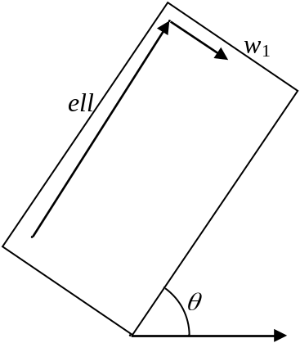
Planner
  A Rectangle is defined by 5 variables:
    Center (2), Orientation (1), Length (ell) and Width (w) (2)
  Each SRU has a path-length (L)
  The set of allowable rectangles is constrained as follows
    The track spacing s, leg length t, and path length L must satisfy
    Rectangles can not overlap
  An allowable rectangle specifies (almost) a path
  From the path (set of legs) we can compute

Slide 18
Mathematical Formulation
  Constrained Optimization problem with 5n variables, where n is the number of SRUs.
  Use iterative techniques for “solving” the problem
  Need initial solution
  Need algorithm for iterating. Three Steps:
    Iterate to a feasible solution (decrease overlap to zero).
    Iterate to a local maximum (increase POS).
    “Jump” an SRU to look for a different local maximum.

Slide 19
Computational Strategy(1)
  POS can be approximated 3 ways:
    1. POS-A (Fastest but least accurate): Uses POC * POD, where:
      POC is “probability of containment;” the proportion of particles that are in the rectangle
      POD is “probability of detection;” the probability of detecting a particle given that is known to be in the rectangle
      In general, POC goes up for bigger rectangles, and POD goes down.
    2. POS-B (Slower than POS-A but a good approximation to POS-C (below))
      Computes POS particle-by-particle for every leg of every SRU, but downsamples the particles.
    3. POS-C (Exact: Used to report the results)
      Computes POS particle-by-particle for every leg of every SRU, and for every particle.

Slide 20
Computational Strategy(2)
  Use POS-A while looking for a feasible solution
    Decrease the overlap of the rectangles while keeping POS-A as high as possible.
  When no overlap, use POS-B
  Technically, we are supposed to maximize POS-C, but we maximize POS-B, and then compute and report POS­C.

Slide 21
Basic Algorithm: Initial Placement
  Greedily place the first SRU:
    Align with the mean drift
    Look for a rectangular array of cells by starting with the best cell and adding/subtracting rows and columns until we can’t improve the POS, using method “A” to approximate POS.
  Update the probabilities of the particles.
  Place the second SRU.
    Allow overlap, but only some overlap.
      Goal is to leave us with a “fixable” amount of overlap during the second part of the algorithm
  Place third and remaining SRUs similarly.
  At each step, maintain “admissibility”
    Admissible sets can have their overlaps cleared with small adjustments.

Slide 22
Basic Algorithm: Improve it
  “Poor man’s gradient method.”
    Used because of the discrete nature of the “length variable.”
    Also known as “refine” or “zero-in.”
  Each SRU has 14 possible “minor moves.”
    Examples:
      Move up ¼ nmi
      Expand to the right
      Contract to the left
  For each SRU, check each “minor move.”
    Make the move and check that move again if it:
      Increases POS, and doesn’t increase overlap, or
      Decreases overlap, and doesn’t decrease POS.
  When stuck at a local maximum, “Jump” one of the SRUs.

Slide 23
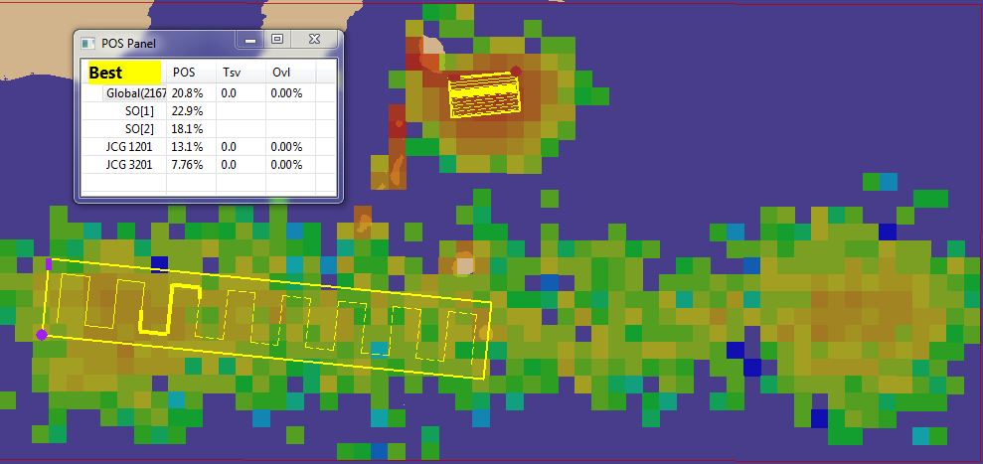
Picture of Planner Solution
One SRU went to the northern mode
The second focused on the left of the southern

Slide 24
Planner: Remaining Work
Better Initial Solutions
Better Choice of Minor Moves
  E.g, Some that are not the movement of a single SRU
Re-define what to Maximize
  Probability of finding Object AND Object is Alive
  Probability that Object is not expired
    No credit given for finding something that would be alive anyway
Use Optimization Libraries
  Use real gradient searches by introducing Path-Length as a sixth variable for each SRU, OR
  Solve problems for a fixed value of length, and combine results

Slide 25
Backup Slides

Slide 26
History and Background (3)
Team and Roles:
  Northrop Grumman is the prime
  Applied Science Associates: GUI and EDS
  Metron: Simulator and Planning Algorithms
More Information on the Web:
  http://www.military.com/news/article/coast-guard-news/cg-assists-in-search-for-air-france.html?col=1186032366581
  http://en.wikipedia.org/wiki/Search_and_Rescue_Optimal_Planning_System_(SAROPS)
  http://www.scientificamerican.com/article.cfm?id=people-lost-at-sea-found

Slide 27
Software Component:
GUI, EDS, SIM
SAROPS is the overall Program
Computational Engine (called SIM) is a Service
Workflow
  GUI collects information from user:
    Where, when, hypotheses on what happened
  Information on winds and currents are gathered from EDS
  Writes the information into an Xml file and environmental data files
    3 files; 1 model file (xml), 1 wind file (netcdf), and 1 currents file (netcdf)
  SAROPS sends SIM the 3 files and SIM creates a file of distributions (one for each 20-minute time period)
  SAROPS gathers more information about the search assets
  SAROPS asks SIM for a suggested search plan

